Slide 1
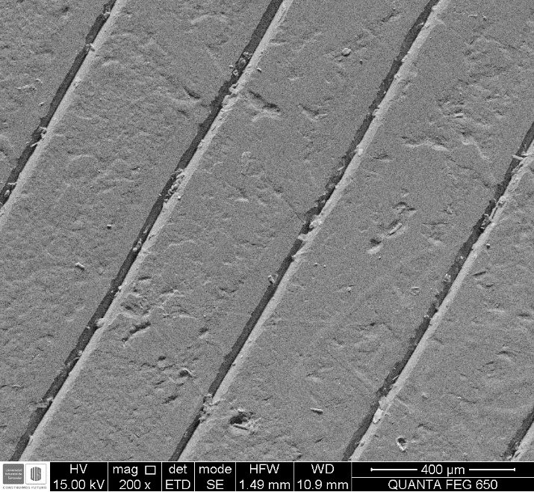
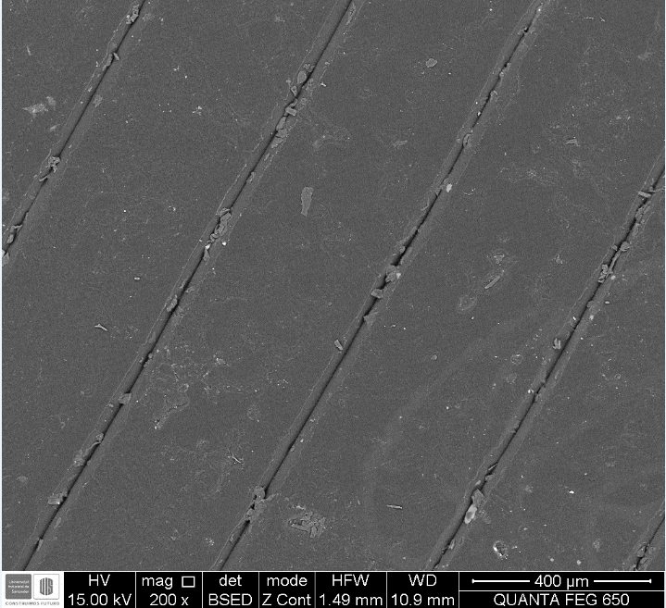



SEM ANALYSIS
SAMPLE INFORMATION: The following images correspond to sample 1 , which was an AM composite manufacture from carbon fiber and Nylon White, with reinforcement in 90°. Sample was evaluated in pure tension.
In this image we can identify the Surface of the AM part, particularly the size of the bead, some superficial imperfections as well as the interbead gaps. The size of the bead is around 400 micrometers, while the gap could reach dimensions of 50 micrometers. We observe in red some resin poor regions being of size 50 micrometers in their longest dimensión on average. The Purple zones identify resin rich regions, wich are larger in extension than resin poor regions. In Blue we can see some interbead gaps defects, possibly scarps.

Slide 2
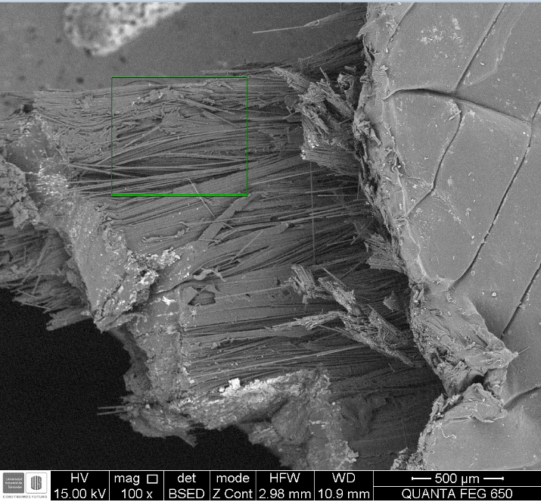
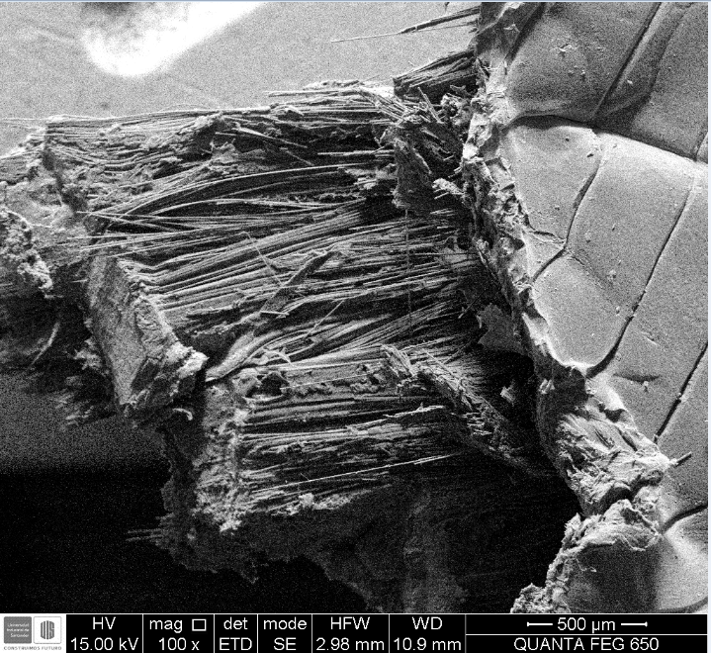
In this images we can identify the slip planes of 90° samples it is to note the relatively flat surface generated as well as the serrated profile. The crack path sequencing can be deduced the fiber region fails first then the surface.

Slide 3
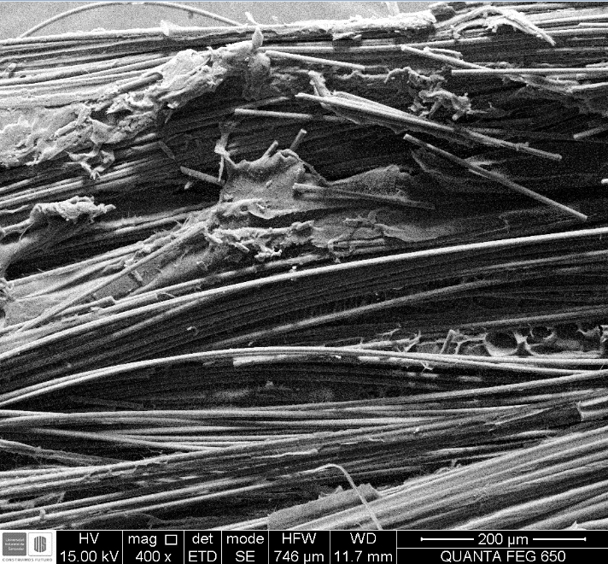
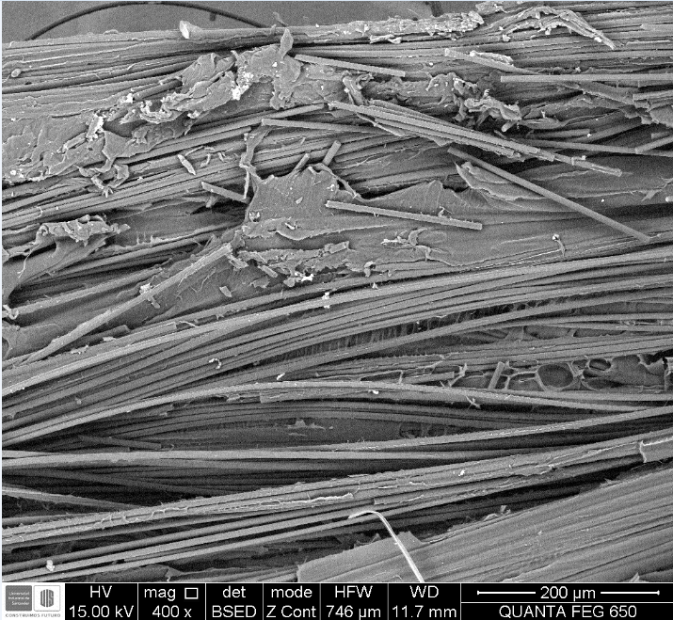

Slide 4
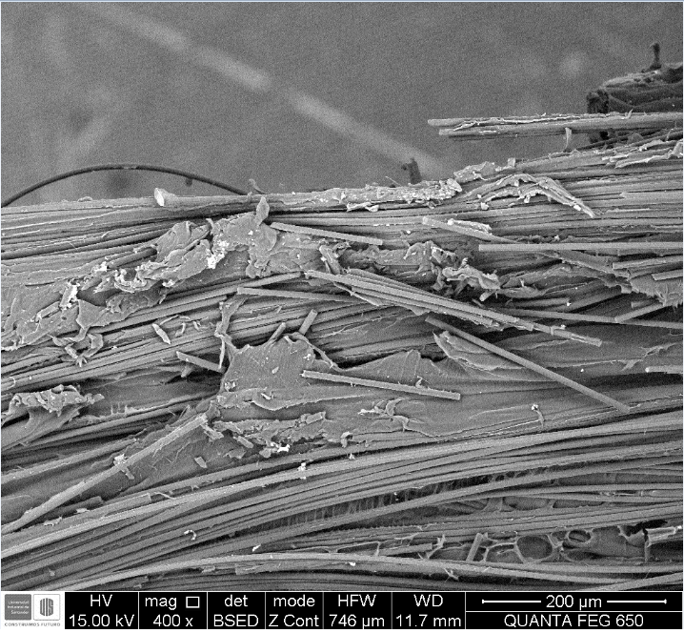
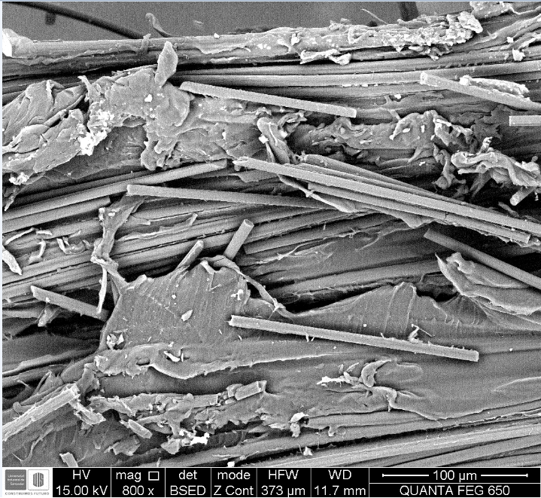

Slide 5
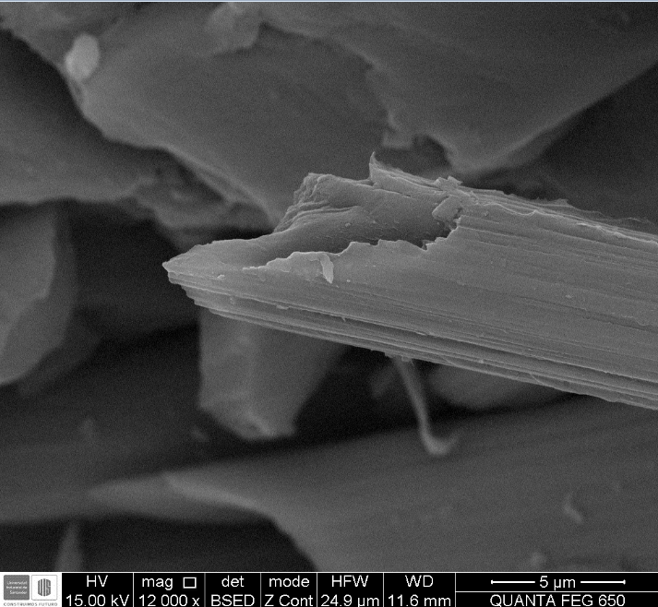

Slide 6
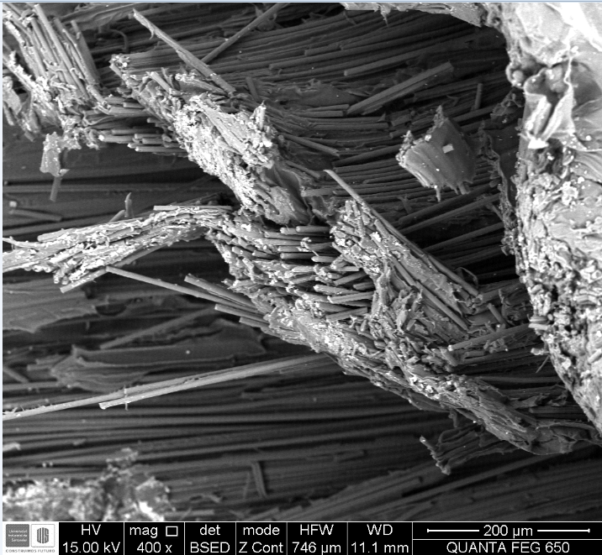
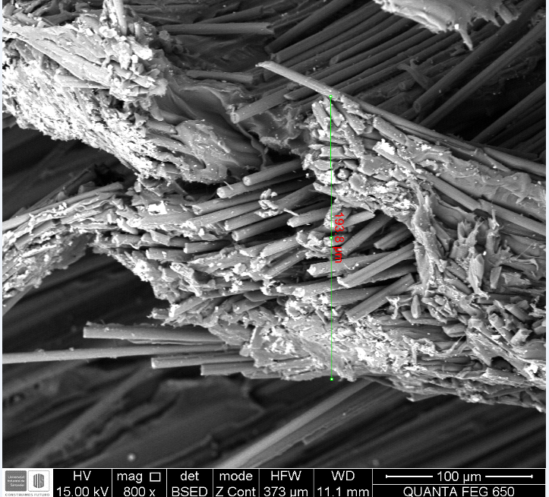

Slide 7
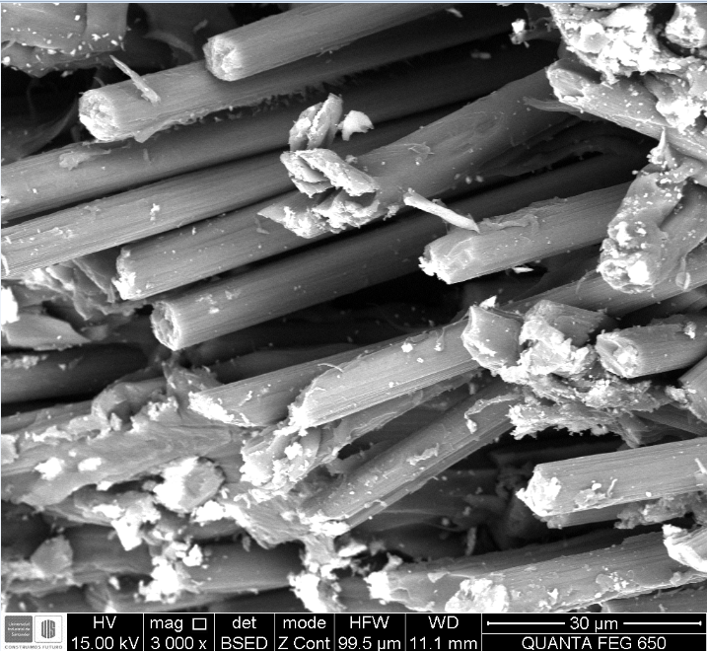

Slide 8
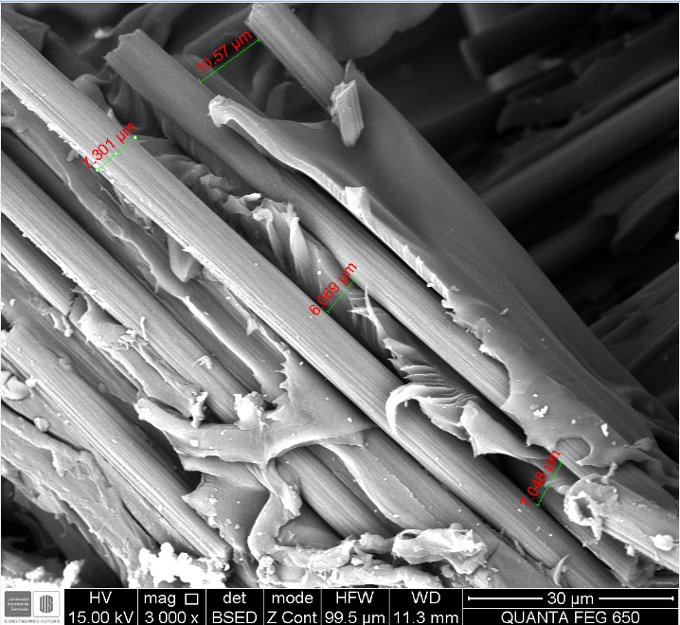
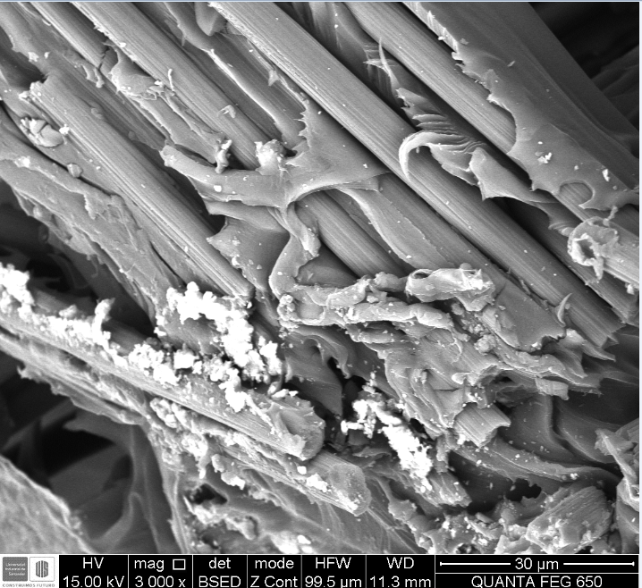
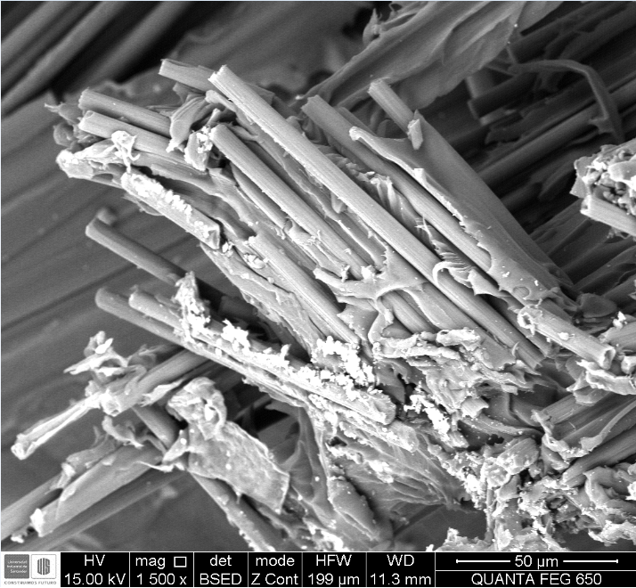

Slide 9
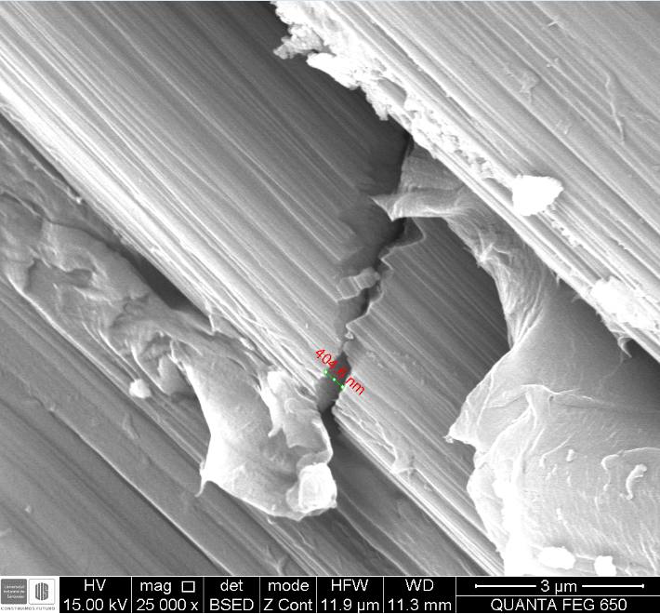

Slide 10
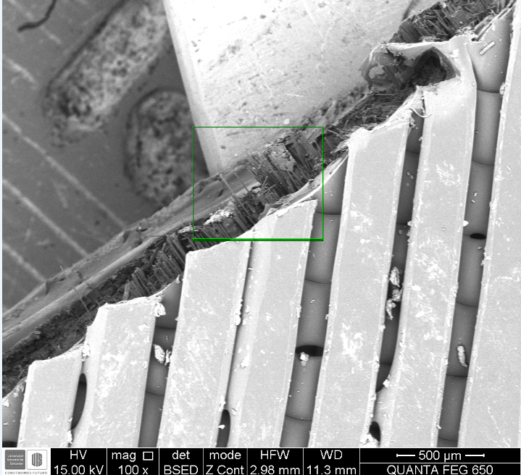
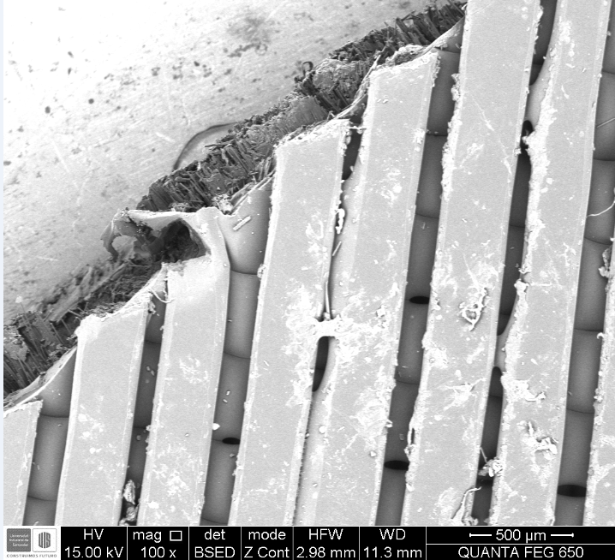
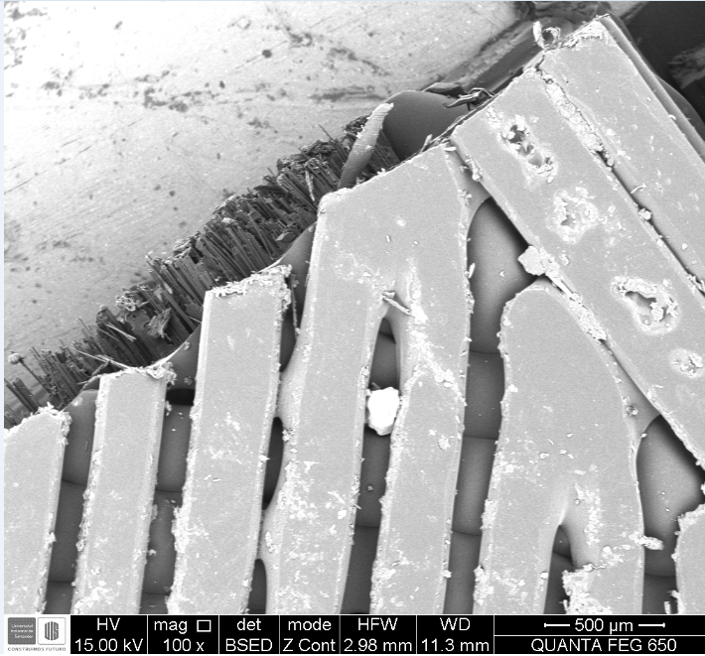
SAMPLE INFORMATION: The following images correspond to sample2, which was an AM composite manufacture from carbon fiber and Nylon White, with a Layer configuration as indicated. Sample was evaluated in pure compression originating a buckling.

Slide 11
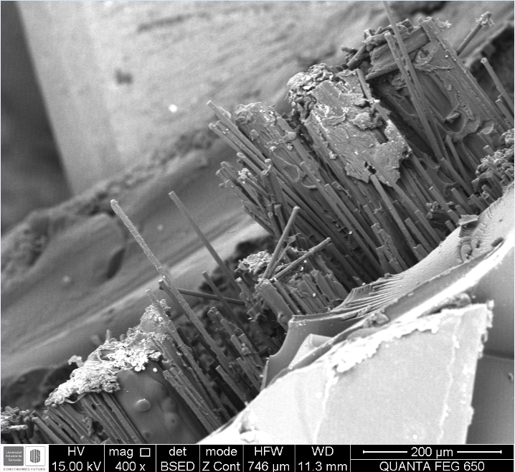

Slide 12
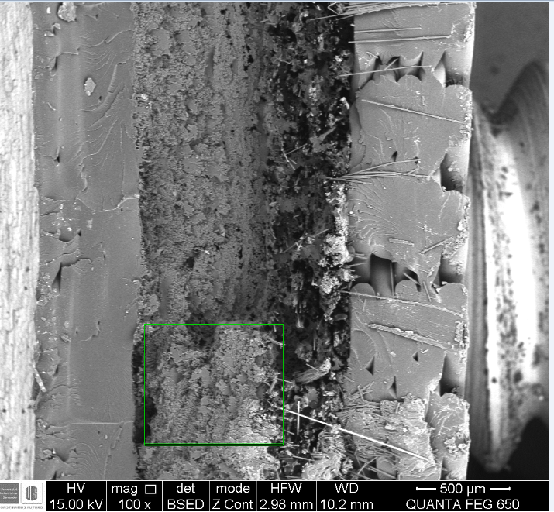




Slide 13
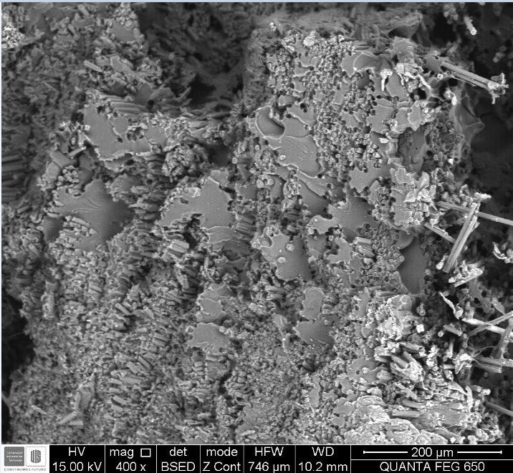

Slide 14
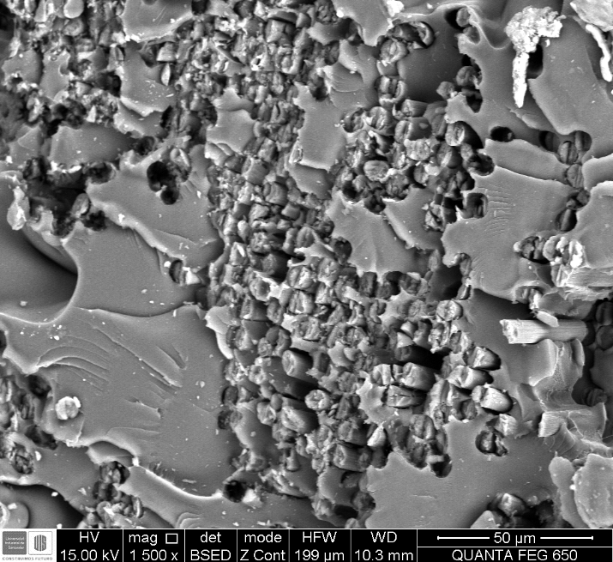

Slide 15
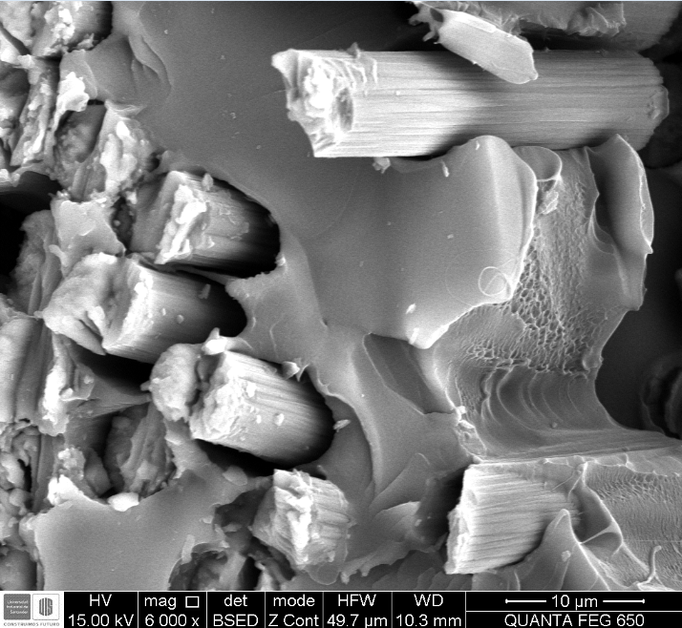

Slide 16
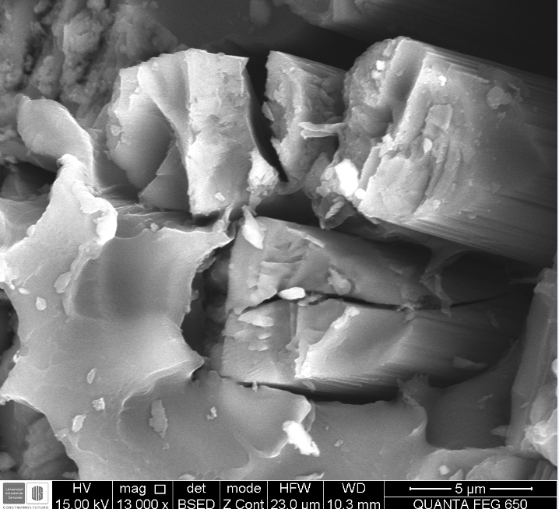

Slide 17
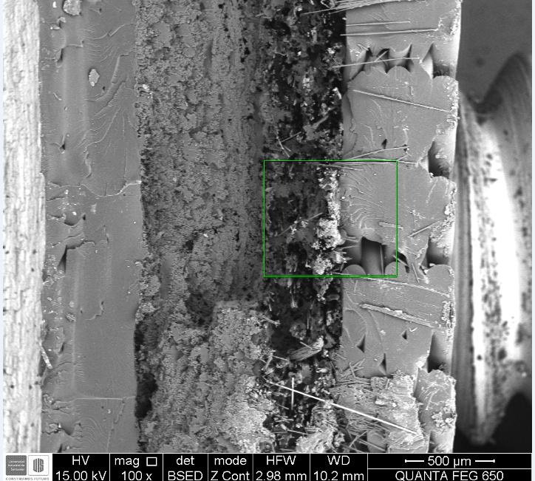

Slide 18
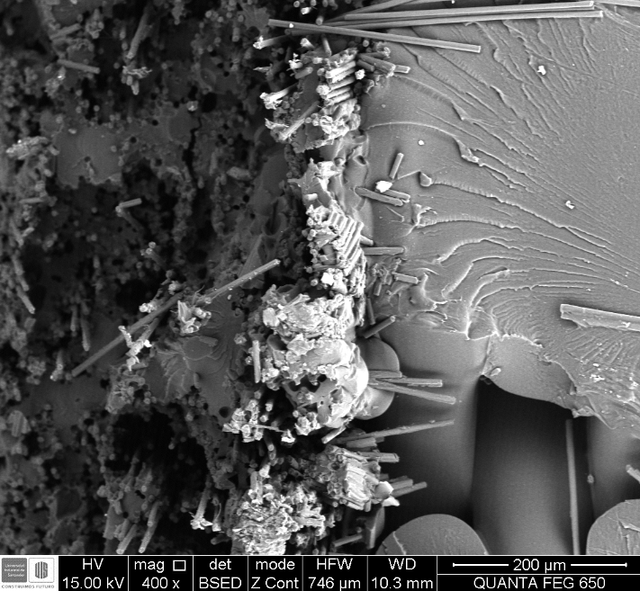

Slide 19
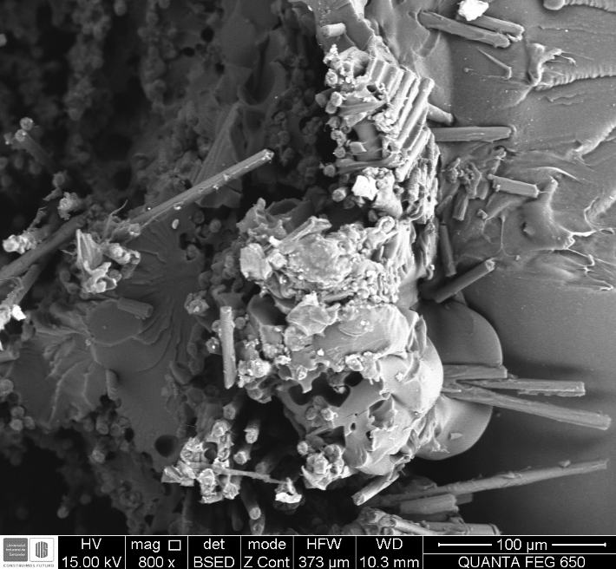

Slide 20
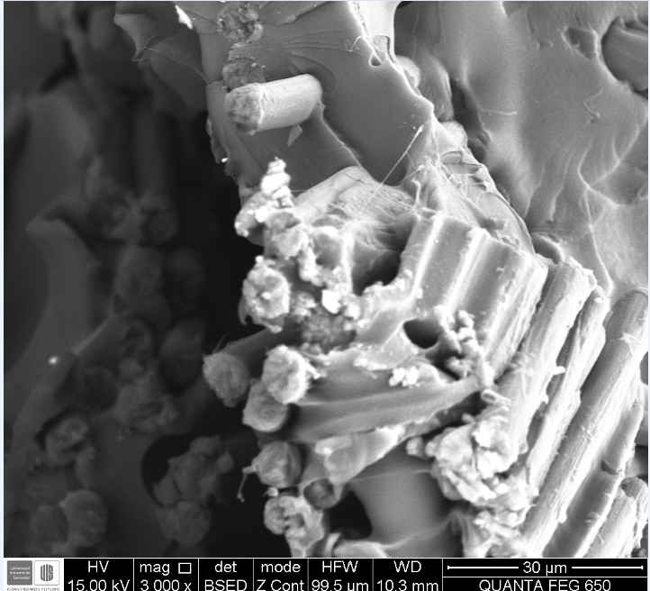

Slide 21
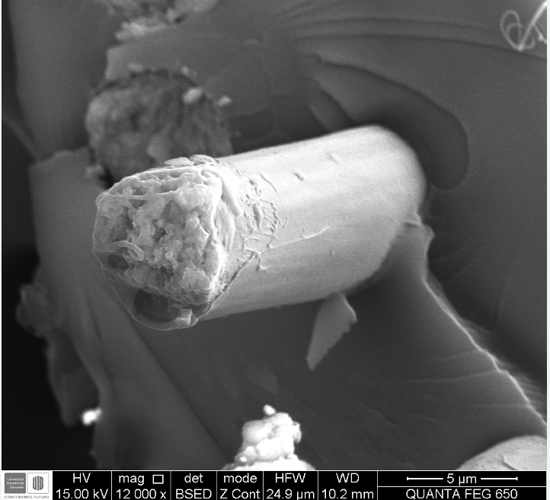

Slide 22
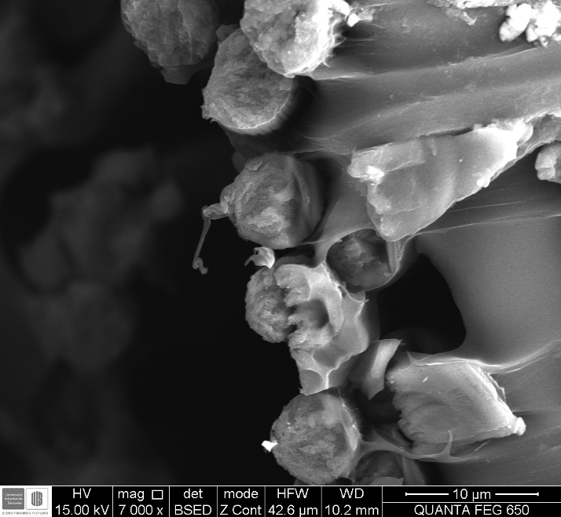
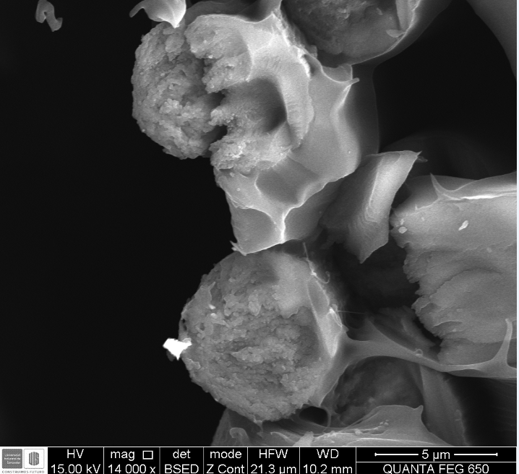

Slide 23
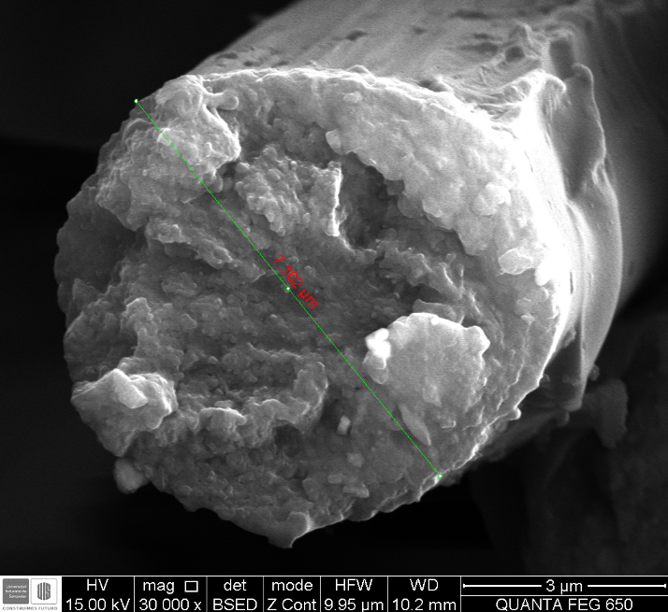

Slide 24
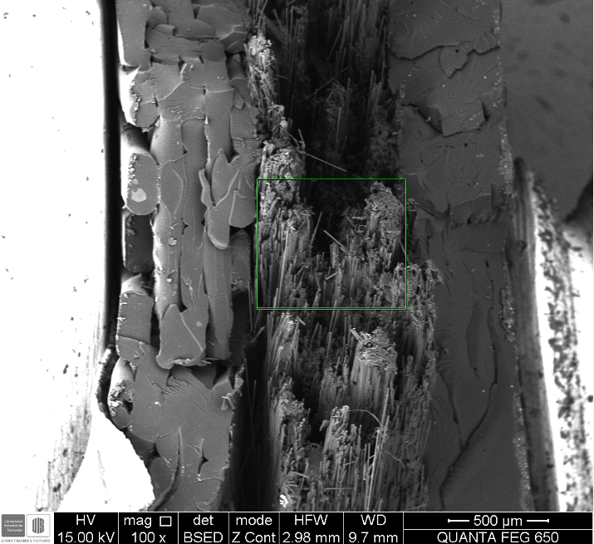
SAMPLE INFORMATION: The following images correspond to sample3, which was an AM composite manufacture from carbon fiber and Nylon White, with a Layer configuration as indicated 0°. Sample was evaluated in pure tension originating brittle fracture

Slide 25
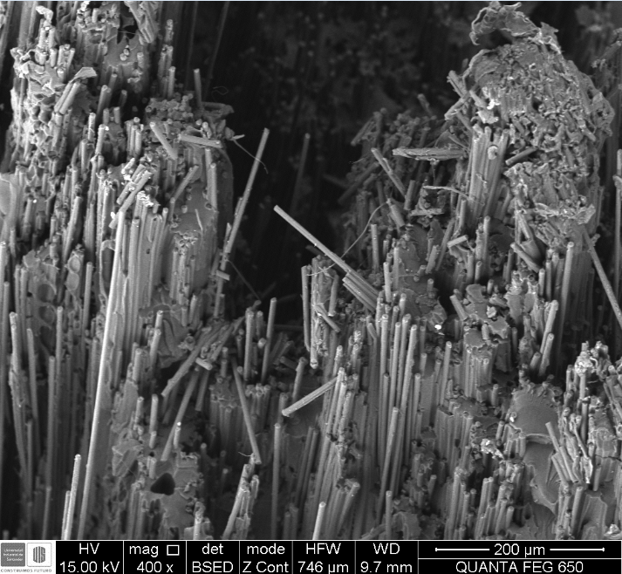

Slide 26
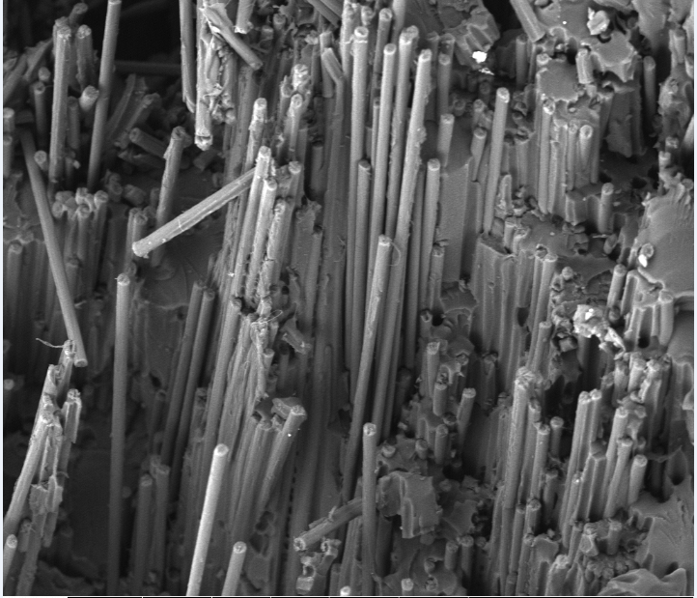

Slide 27
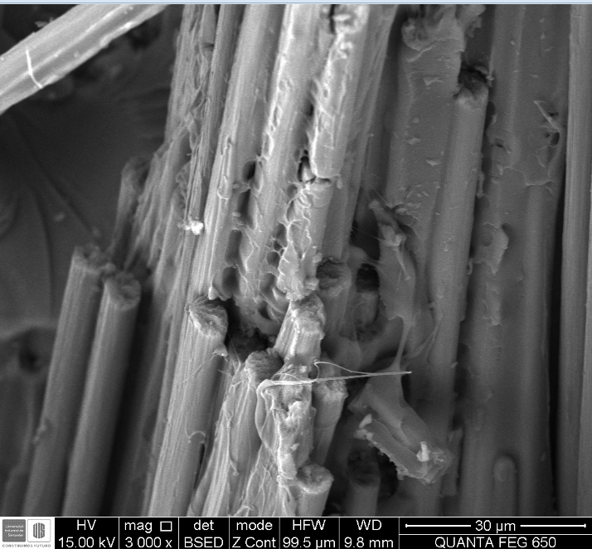
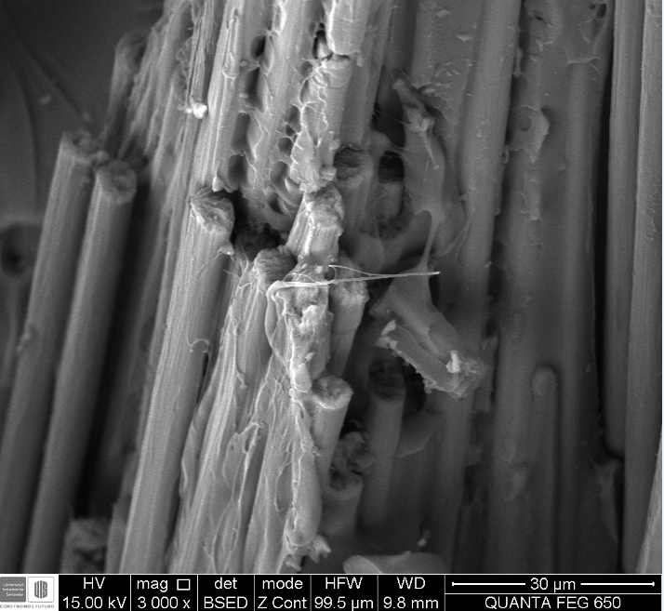

Slide 28
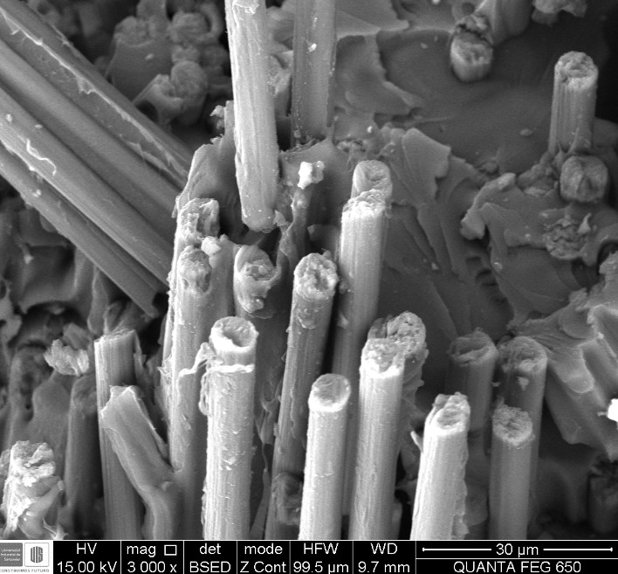

Slide 29
